Slide 1
2
A
B
6
1
4
8
E
7
C
D
3
Step -1:
Sort all the connected edges in descending order:
B - C = 1
B - A = 2
D - E = 3
A - C = 4
B - E = 6
C - D = 7
B - D = 8

Slide 2
2
A
B
6
1
4
8
E
7
C
D
3
Step -2:
Checked,
B - C is connected and creates no cycle in the graph. So we can take it.
Edges are:
B - C = 1
B - A = 2
D - E = 3
A - C = 4
B - E = 6
C - D = 7
B - D = 8

Slide 3
2
A
B
6
1
4
8
E
7
C
D
3
Step -3:
Checked,
B - A is connected and creates no cycle in the graph. So we can take it.
Edges are:
B - C = 1
B - A = 2
D - E = 3
A - C = 4
B - E = 6
C - D = 7
B - D = 8

Slide 4
2
A
B
6
1
4
8
E
7
C
D
3
Step -4:
Checked,
D - E is connected and creates no cycle in the graph. So we can take it.
Edges are:
B - C = 1
B - A = 2
D - E = 3
A - C = 4
B - E = 6
C - D = 7
B - D = 8

Slide 5
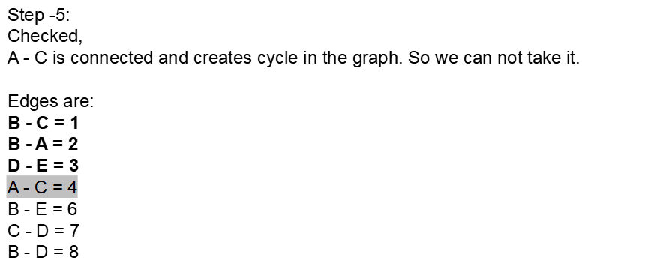
2
A
B
6
1
4
8
E
7
C
D
3

Slide 6
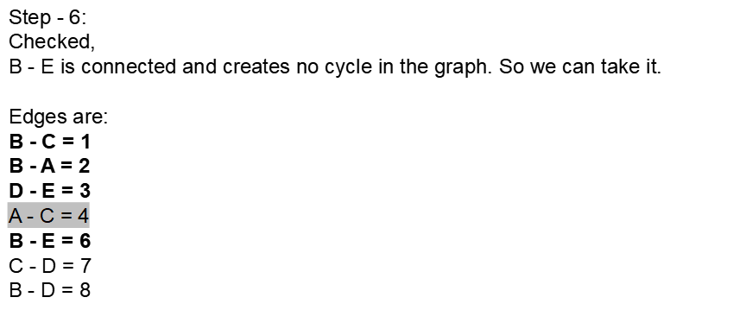
2
A
B
6
1
4
8
E
7
C
D
3

Slide 7
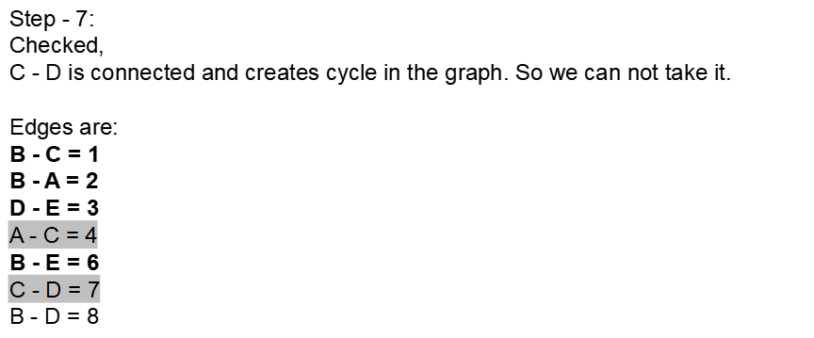
2
A
B
6
1
4
8
E
7
C
D
3

Slide 8
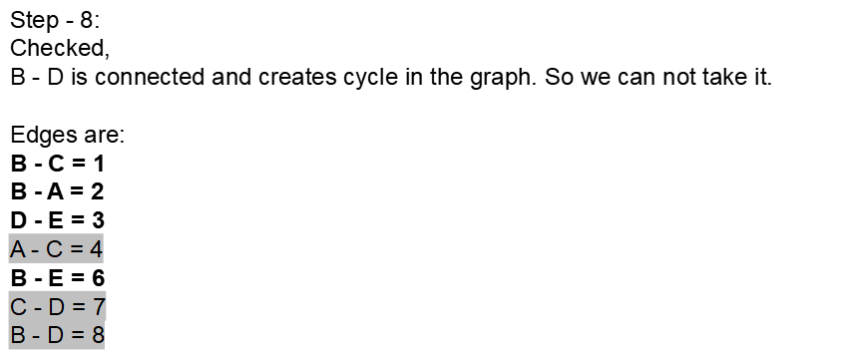
2
A
B
6
1
4
8
E
7
C
D
3

